Slide 1
CSCB09
Lab W2 — The Shell
Summer ’23 TUT1 TA: Ian Gregory – ian.gregory@mail.utoronto.ca

Slide 2
Course Geography
This is the software tools part of the course
we will get to systems programming in a couple of weeks (June)

Slide 3
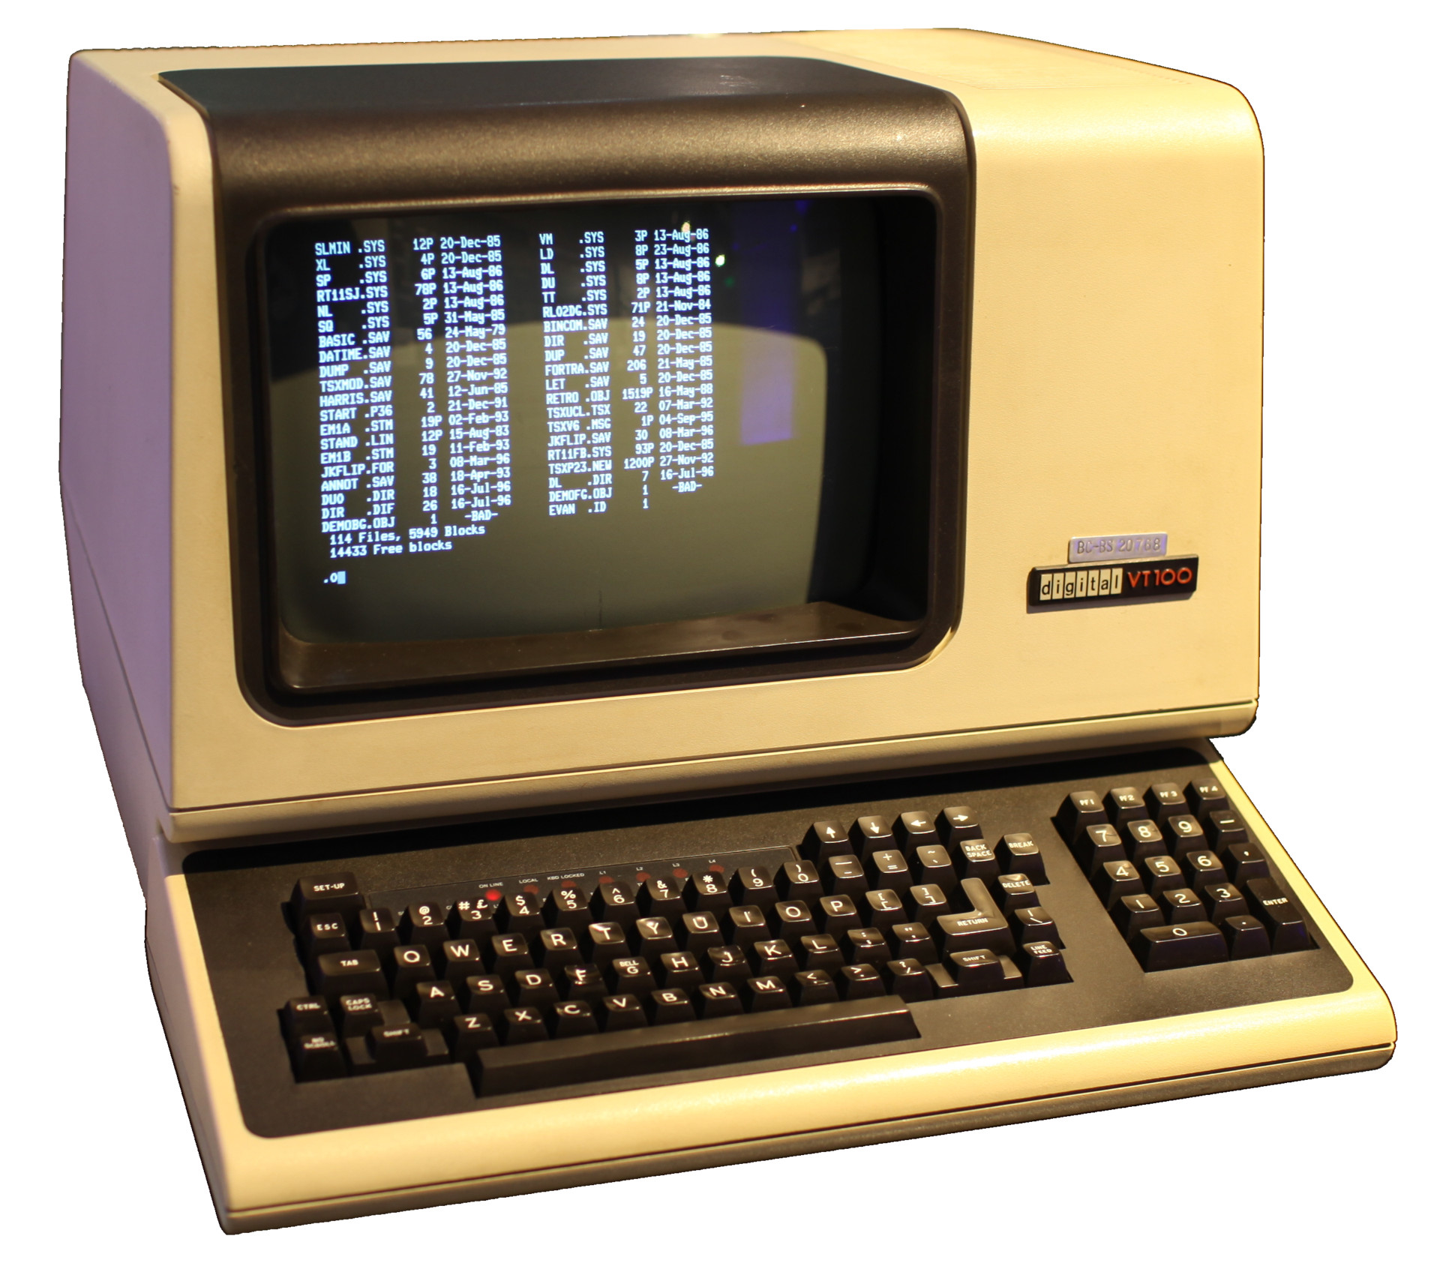
What is “the shell”?
In the Unix & Linux world, usually a command line interface for starting, stopping, and interacting with programs
POSIX, a unifying standard for Unix-like systems, specifies behaviour of the default shell, called sh
Interactive use is often done through a terminal emulator program (terminal for short)
Q: emulator? What is being emulated? A: Ancient thin-client hardware devices called terminals; this is a VT100 →
“Shell” refers more generally to user interfaces that provide direct interaction with the operating system
It’s the pleasant, “outside” part of the OS, which most people see and use
e.g., Windows Shell means the Windows desktop UI
Command-line interfaces are user interfaces!

Slide 4
How to use the shell
Working directory: Directory (folder) where files will be found when issuing a command
cd: change [working] directory
pwd: print working directory
Scroll through history to see or repeat a previous command: ↑ and ↓ keys
Ask the running program to terminate: Ctrl+C / ⌃C
Basic documentation for most commands is available in man pages
type man cmd into the shell
(or google that phrase; man7.org is maintained by the author of our textbook)
“man” is an (unfortunate) abbreviation for (instruction) manual
presumably from when technology came with comprehensive paper books detailing how to use it :’)

Slide 5
How the pieces fit together – Intro slide 9

Slide 6
small aside — What really is sh (the Linux shell)?
Initially: Interactive command line processor
But also: High-level, interpreted programming language
high-level: hides irrelevant implementation details—in particular, it does all the talking to the operating system kernel
we will do this ourselves in a few weeks (systems programming)
interpreted: program called an interpreter reads and immediately executes programs
easy to implement and use, and extremely flexible, at the cost of performance—no upfront program optimization, and interpreters eat CPU cycles for breakfast
a familiar example: Python (with CPython as the interpreter)
contrast with compiling code upfront (as often done for C, Rust, Java, Scala, Swift, …)
Python can also be compiled; see Cython, or the recently announced and much-hyped Mojo language
You will see how to write shell scripts (i.e., programs) in lecture this week

Slide 7
Lab W2
Exercises to help you get comfortable working with the Linux command shell
Instructions on the course website (linked from Quercus) https://www.cs.utoronto.ca/~trebla/CSCB09-2023-Summer/

