Slide 1
CSCB09
Lab W4 — Shell Scripting 2
Summer ’23 TUT1 TA: Ian Gregory – ian.gregory@mail.utoronto.ca

Slide 2
Looks can be deceiving…
What is the difference between
echo=env
echo = env
echo= env
?

Slide 3
Looks can be deceiving…
What is the difference between
echo=env
echo = env
echo= env
?
assigns the string "env" to the shell or environment variable $echo
runs command echo with 2 arguments, "=" and "env"
runs command env with environment variable $echo set to empty string

Slide 4
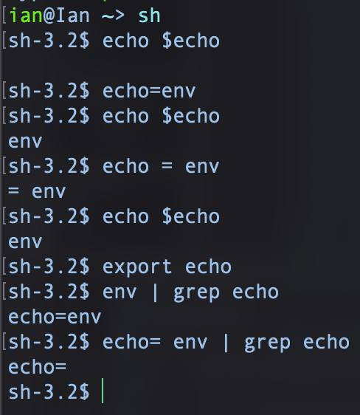
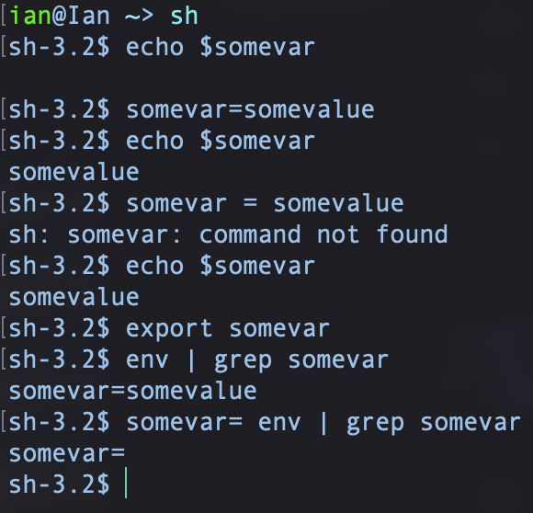
Looks can be deceiving…
Try it yourself:
An isomorphic interaction (with things renamed for clarity):

Slide 5
Lab W4
More shell scripting! Transpose directories
transpose: interchange, exchange, switch, swap (around), transfer, reverse, invert, rearrange, reorder, turn around, change (around), move (around), substitute, trade, alter, convert.

